Slide 1

DATA ANALYTICS PROJECT @

Slide 2
COFFEE SHOP DATA ANALYSIS
PRESENTER
DR SAMUEL ISRAEL

Slide 3
OVERVIEW:
Introduction
Detailed steps for each analysis
Insights
Recommendations
Thanks

Slide 4
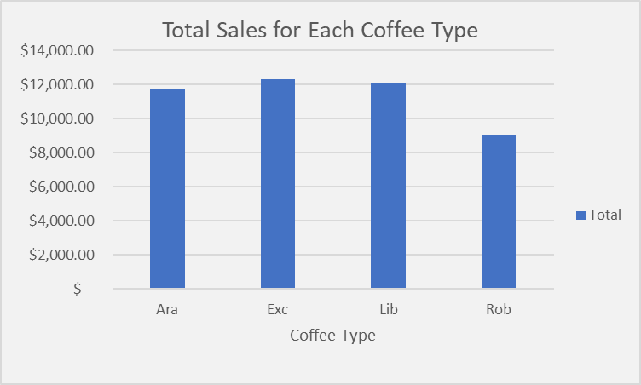
Detailed steps of the analysis
Find trends of total sales by each coffee type:
Open the dataset in Excel
Using VLOOKUP, merge the orders and product data using ‘product ID’
Create a new column, and calculate total sales by multiplying quantity (from the order table) by unit price (from the product table)
Analyze sales trends over time using Pivot table
Visualize (pivot chart) plot the sales trends for each coffee type
Row Labels | Total Sales
Ara | $ 11,768.50
Exc | $ 12,306.44
Lib | $ 12,054.08
Rob | $ 9,005.25

Slide 5
Generate a table or chart highlighting the top 10 customers based on their contribution to total sales;
Merge orders and customers data using ‘customer ID’ using VLOOKUP
Calculate total sales by multiplying quantity by unit price
Group the data by ‘customer ID’ and sum the total sales for each customer
Sort the customers in descending orders based on their contribution to total sales
Extract the top 10 customers
Analyze using Pivot table
Visualize (bar chart)
Row Labels | Sum of Total Sales
Alexa Sizey | 218.73
Claudetta Rushe | 189.75
Daniel Heinonen | 204.93
Elysee Sketch | 204.93
Hatty Dovydenas | 189.75
Lacee Tanti | 204.93
Lemuel Rignold | 200.79
Nanny Lush | 204.93
Shelli Keynd | 204.93
Teddi Crowthe | 204.93

Slide 6
Find total sales by each country;
Merge orders, customers and product data using customer ID and Product ID
Calculate total sales, multiply quantity by unit price to get the total sales for each order
Group the data by country (from the customer table) and sum the total sales for each country
Sort by total sales and analyze using Pivot table
Visualize (pivot chart) plot total sales by each country
Row Labels | Total Sales
Ireland | $ 6,696.87
United Kingdom | $ 2,798.51
United States | $ 35,638.89

Slide 7
Find the total quantity ordered for each coffee type;
Merge orders and products data using ‘product ID’ by VLOOKUP
Sum the quantity column for each coffee type to get the total amount ordered
Sort the coffee type by total quantity ordered using Pivot table
Visualize (pivot chart) plot total quantity ordered for each coffee type.
Row Labels | Total Quantity
Ara | 947
Exc | 872
Lib | 854
Rob | 878

Slide 8
INSIGHTS
Orders data
There are 957 distinct orders placed on 689 different dates between 2019 and 2022.
Customer data
204 customers do not have an email listed and 130 customers are missing phone numbers.
The dataset highlights a distinction between loyalty card members and non-members providing an opportunity for customer segmentation.
Product data
The coffee shop offers 48 unique products categorized by coffee type and roast type
Product prices range from $2.68 to $36.45 with profit margins varying significantly from $0.16 to $4.73
Larger product sizes tend to have lower costs per 100g, which could incentivize bulk purchases.

Slide 9
RECOMMENDATIONS
Encourage customers to provide missing contact details, such as email addresses and phone numbers, to enhance marketing efforts and communication.
Segment the customer base by loyalty membership and create targeted promotions or rewards to boost engagement and increase repeat purchases from loyalty members.
Focus marketing and promotions on products with higher profit margins, especially larger sizes that offer better value per unit weight
Introduce product bundles that combine smaller, less profitable items with larger, more profitable products to drive overall sales.
Investigate patterns in ordering behavior to identify high-demand periods, such as holidays or weekends. This will support better inventory management and promotional planning.

Slide 10
Thank you @

